Slide 1
Sub Commander
Accessible Game - SS12: Project Possibility
Evan Greenstone, Patrick Fay, Anoop Kamboj, Alex Silkin
Notes:
Anoop

Slide 2
The Task
Create an interactive experience to be played by individuals with visual impairments
Our Goal
Create a game that only relies on the auditory senses
Notes:
Make a game that does not depend and visuals at all, yet still is able to communicate information to the player clearly.
Ensure that the game provides a unique experience.
Make a game that is compelling no matter who you are.
Callenges – make the game appropriately difficult + excite the player

Slide 3
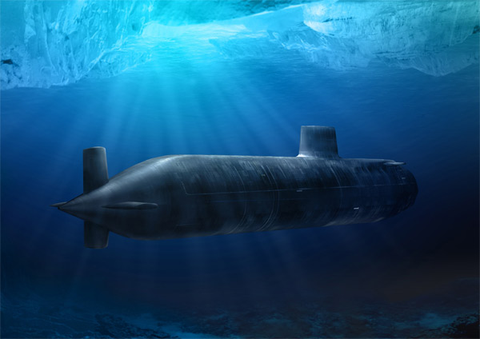
Final Design
Feels natural to play a submarine game using sound
Crew’s feedback aids immersion
Notes:
Submarines are blind and are forced to rely on their instruments to navigate the oceans
Different crew members with different

Slide 4
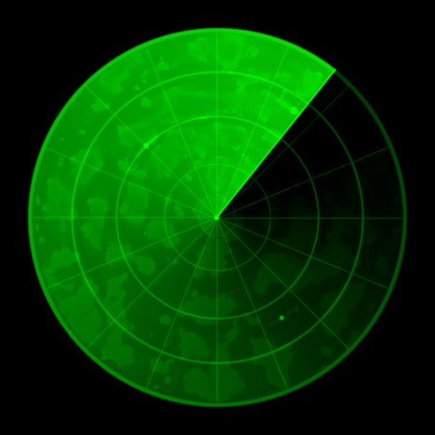
Technical
Sonar algorithm
Aim assist
Calculating stereo audio
Audio cueing
Debugging
Notes:
We actually emulate how a radial sonar works and it allows us to have several objects in the game at one time.
A real arcade game behind the scenes.

Slide 5
Sound Engine
Dynamically load files
Load sounds with different volumes in different audio channels
Dynamically change these values
Dialog – queuing, passive, aggressive

Slide 6
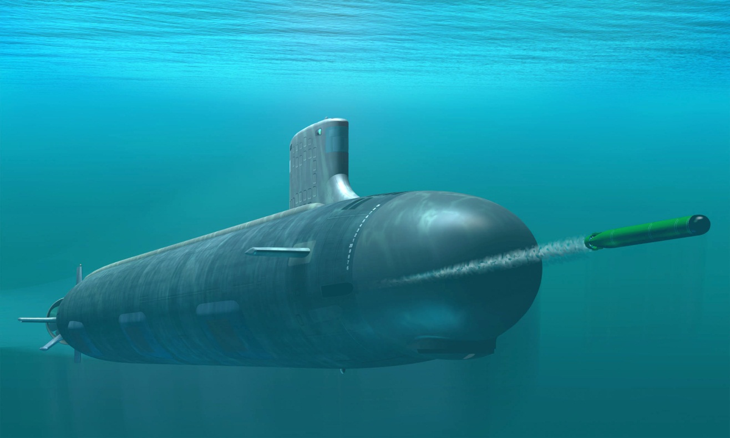
Gameplay
Notes:
Using sonar to locate and identify targets is very natural, and is something that many people are already familiar with.
Different pings for different objects
Shooting missiles – more fun than just navigating to targets

